Slide 1
Unit Testing in Groovy
Daniel Dingess, Alex Heavner, and Matt Gaines

Slide 2
What is Groovy?
Groovy is a powerful super-language for the Java platform that integrates smoothly with any Java program.
Groovy is an optionally typed and dynamic language, with static-typing and static compilation capabilities. It boasts powerful features such as Specific Language authoring, runtime and compile-time meta-programming and functional programming.

Slide 3
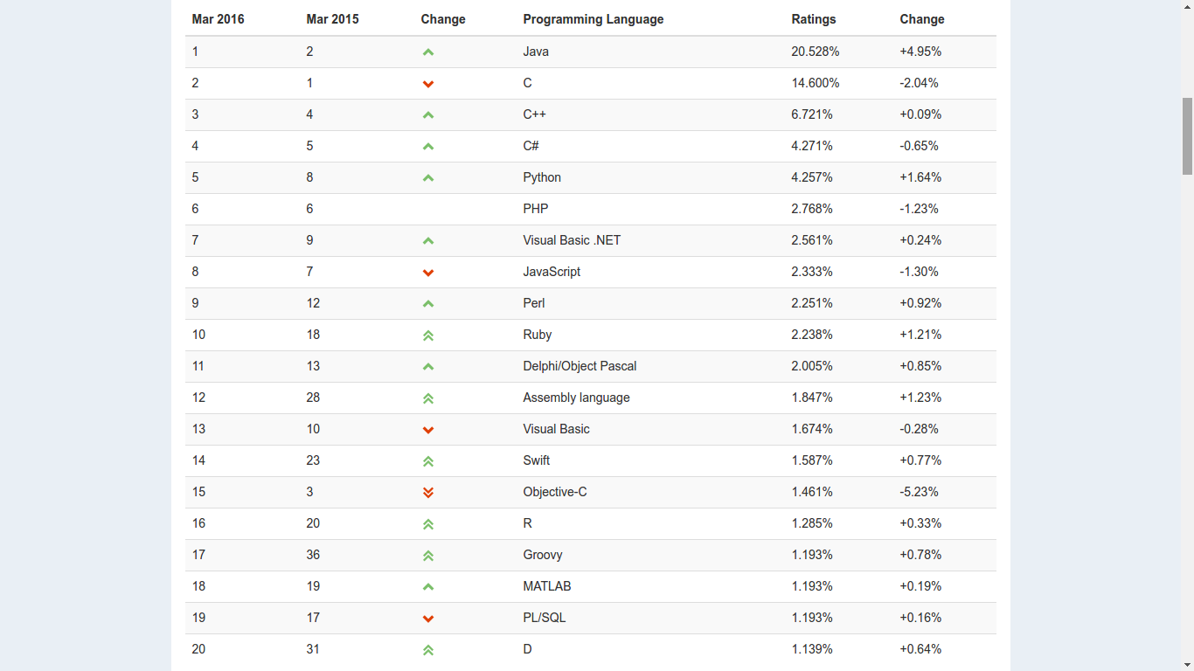
Why use Groovy?
Pros
Dynamic Typing
Java-like Syntax
Meta-programming
High Quality Tooling
Powerful Testing Suite
Easy to use.
Cons
Speed
Low Documentation
*Programming Language Popularity from tiobe.com

Slide 4

Language Testing Features
Groovy has integrated support for JUnit 3 & 4.
In addition, Groovy has many testing features, like:
Power Assertions
Mocking and Stubbing
Tool Support

Slide 5
Power Assertions
In Groovy, the assert statement is a power assertion statement, meaning the boolean expression output validates false.
def x = true
def y = false assert x == y Caught: Assertion failed: assert x == y | | | | | false | false true
def x = [1, 2, 3] assert x == [3, 2, 1] Caught: Assertion failed: assert x == [3, 2, 1] | | | false [1, 2, 3]
assert new File('foo.bar') == new File('example.txt')
Caught: Assertion failed:
assert new File('foo.bar') == new File('example.txt')
| | |
foo.bar | example.txt
false

Slide 6
Mocking & Stubbing
Mocking: a class that implements an interface and allows the ability to dynamically set the values to return/exceptions to throw from particular methods and provides the ability to check whether a particular method has been called or not.
Stubbing: like mocking except that there is no ability to verify that a method has been called.

Slide 7
Mocking & Stubbing (Cont.)
A closure in Groovy is an open, anonymous, block of code that can take arguments, return a value and be assigned to a variable.
In Groovy testing, we coerce the closure to do something, like be a specific type:
def service = { String key -> 'some text' } as TranslationService assert 'some text' == service.convert('key.text')
Single Abstract Method (SAM) Coercion means the as operator is not necessary in situations where the runtime can infer the target SAM type.

Slide 8
Mocking & Stubbing (Cont.)
By using maps, we can also incorporate desired behaviour of a collaborator:
class TranslationService { String convert(String key) { return "test" } } def service = [convert: { String key -> 'some text' }] as TranslationService assert 'some text' == service.convert('key.text')

Slide 9
MockFor & StubFor (groovy.mock.interceptor)
MockFor class supports testing of classes in isolation by allowing a strictly ordered expectation of the behavior of collaborators to be defined.
class Person { String first, last } class Family { Person father, mother def nameOfMother(){ "$mother.first $mother.last" } }
*Sample classes
The expectation for MockFor is always sequence dependent and it automatically ends with a verify call.
def mock = new MockFor(Person) mock.demand.getFirst{ 'dummy' } mock.demand.getLast{ 'name' } mock.use { def mary = new Person(first:'Mary', last:'Smith') def f = new Family(mother:mary) assert f.nameOfMother() == 'dummy name' } mock.expect.verify()

Slide 10
MockFor & StubFor (groovy.mock.interceptor)
StubFor class supports testing of classes in isolation as well, but it allows a loosely-ordered expectation of the behavior to be defined.
The expectation for StubFor is sequence independent and the use of verify is optional.
def stub = new StubFor(Person) stub.demand.with { getLast{ 'name' } getFirst{ 'dummy' } } stub.use { def john = new Person(first:'John', last:'Smith') def f = new Family(father:john) assert f.father.first == 'dummy' assert f.father.last == 'name' }
//stub.expect.verfiy()

Slide 11
Expando Meta-class (EMC)
EMC is a special MetaClass which allows the dynamic addition of methods, constructors, and static methods as a closure.
Each Class has a metaClass property that references an EMC.
The EMC allows mocking of static methods and constructors.
The EMC can also be used on the object level.
class Book {String title} Book.metaClass.static.create << { String title -> new Book(title:title) }
def b = Book.create("The Stand") assert b.title == 'The Stand'
Book.metaClass.constructor << { String title -> new Book(title:title) } def b = new Book("The Stand") assert b.title == 'The Stand'
def b = new Book(title: "The Stand") b.metaClass.getTitle {-> 'My Title' } assert b.title == 'My Title'

Slide 12
Questions?

